Slide 1
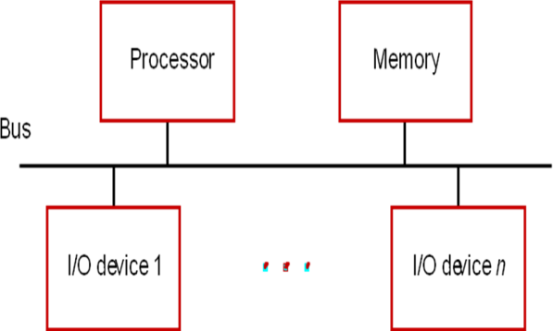
Accessing I/O devices
A simple arrangement to connect I/O devices to a computer is to use a single bus arrangement as shown in the figure below.

Slide 2
The bus enables all the devices connected to it to exchange information.
Multiple I/O devices may be connected to the processor and the memory via a bus.
Bus consists of three sets of lines to carry address, data and control signals.
Each I/O device is assigned a unique address.
When the processor places a particular address on the address lines, the device that recognizes this address responds to the commands issued on the control lines.
The processor requests either a read or a write operation and the requested data are transferred over the data lines.

Slide 3
As a CPU needs to communicate with the various memory and input-output devices (I/O) as we know data between the processor and these devices flow with the help of the system bus. There are three ways in which system bus can be allotted to them :
Separate set of address, control and data bus to I/O and memory (IOP and CPU).
Have common bus (data and address) for I/O and memory but separate control lines (Isolated I/O or I/O mapped I/O) .
Have common bus (data, address, and control) for I/O and memory (Memory mapped I/O).

Slide 4
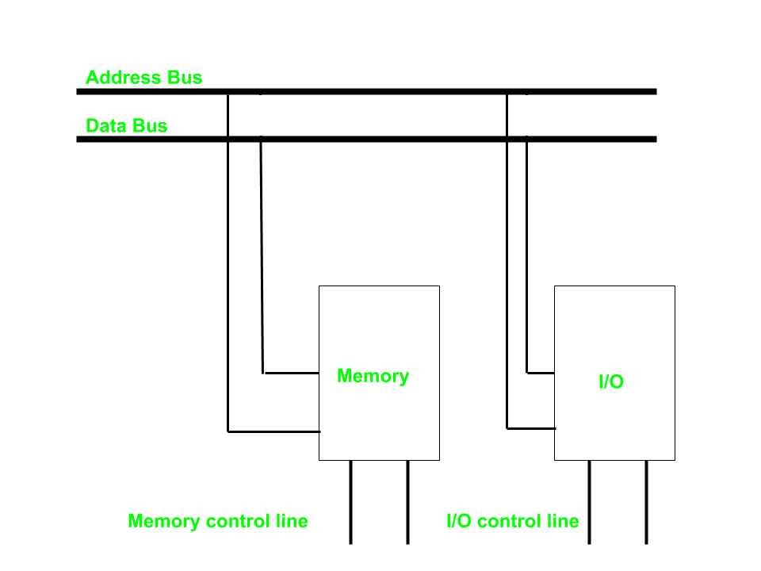
Isolated I/O or I/O mapped I/O– Then we have Isolated I/O in which we Have common bus(data and address) for I/O and memory but separate read and write control lines for I/O. So when CPU decode instruction then if data is for I/O then it places the address on the address line and set I/O read or write control line on due to which data transfer occurs between CPU and I/O. As the address space of memory and I/O is isolated and the name is so. The address for I/O here is called ports. Here we have different read-write instruction for both I/O and memory

Slide 5
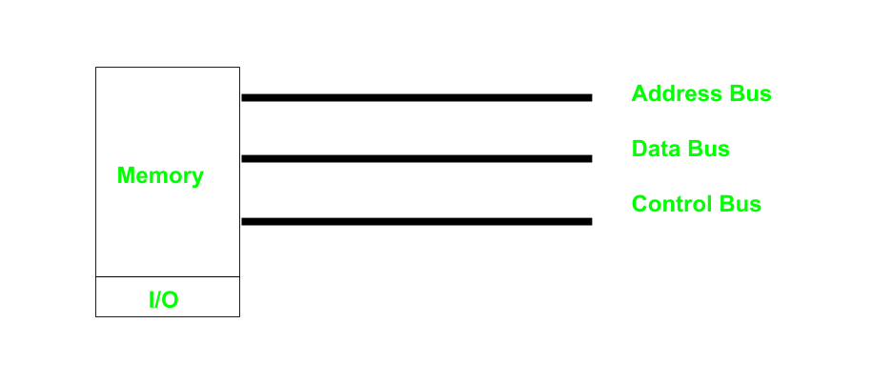
Memory Mapped I/O – In this case every bus in common due to which the same set of instructions work for memory and I/O. Hence we manipulate I/O same as memory and both have same address space, due to which addressing capability of memory become less because some part is occupied by the I/O.

Slide 6
|-----------------------------|
| Memory Addresses |
|-----------------------------|
| Memory |
|-----------------------------|
|-----------------------------|
| I/O Addresses |
|-----------------------------|
| I/O Devices |
|-----------------------------|
Memory mapped
|-----------------------------|
| Memory Addresses |
|-----------------------------|
| Memory |
|-----------------------------|
| I/O Addresses |
|--------------------------- -|
| I/O Devices |
|-----------------------------|
Isolated

Slide 7
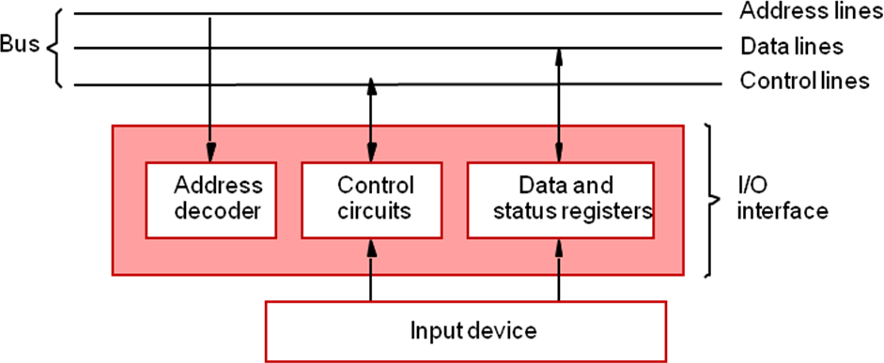
The following figure illustrates the hardware required to connect an I/O device to the bus.

Slide 8
An I/O device is connected to the bus using an I/O interface circuit which has: - Address decoder, control circuit, data and status registers. The address decoder decodes the address placed on the address lines thus enabling the device to recognize its address. The data register holds the data being transferred to or from the processor. The status register holds information relevant to the operation of the I/O device. Both data and status registers are connected to the data bus, and assigned unique addresses. I/O interface circuit coordinates I/O transfers. Recall that the rate of transfer to and from I/O devices is slower than the speed of the processor. This creates the need for mechanisms to synchronize data transfers between them.

Slide 9
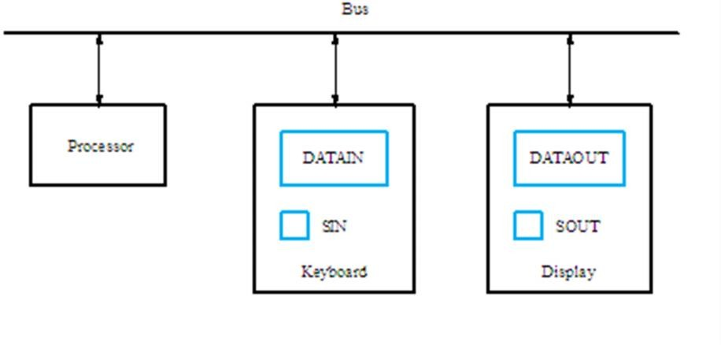
Data transfer between computer and io device can be achieved in following ways:-
Program-controlled I/O: In this method processor repeatedly monitors a status flag to achieve the required synchronization between the processor and an I/O device. Processor polls the I/O device.

Slide 10
2. There are two other mechanisms used for synchronizing the data transfers between the processor and memory:
Interrupts.
Direct Memory Access

